Slide 1
Resource Allocation Tool
Design and Optimization Modeling of Carbon Mitigation InterventioNs In health faCilities
(DOMMINIC)

Slide 2
Project Overview
To develop a mathematical modelling tool for carbon emission analysis in healthcare facilities and resource optimization. It should be able to:
Conduct carbon emission analysis – model carbon emissions in a specific healthcare facility to estimate the central value of carbon emissions
Optimize resource allocation – to assist decision makers and implementers to effectively allocate resources for carbon reduction activities
Have a user friendly interface
Allow continual improvement – new data should be able to improve the performance of the tool

Slide 3
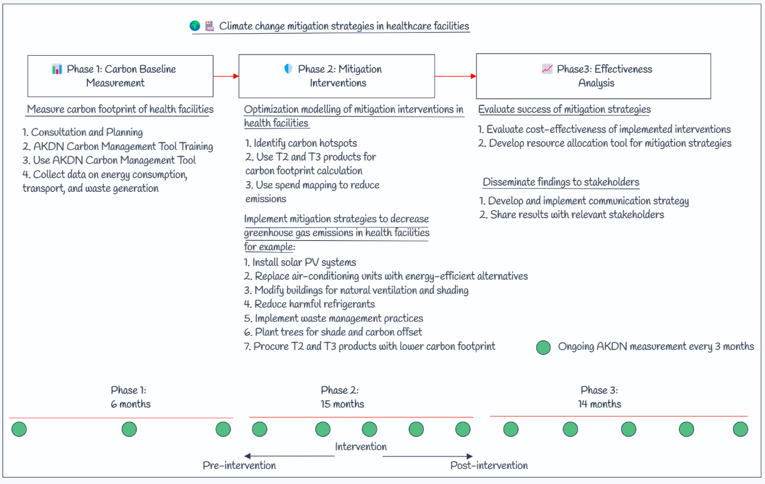


Carbon emission measurement, reductions and evaluation (HIGH Horizons)

Slide 4
Data Available for Use
Utilizing the AKDN carbon management tool.
The AKDN Carbon Management Tool is a web-based tool developed by the Aga Khan Development Network (AKDN) to help AKDN agencies and institutions measure, manage, and reduce their greenhouse gas (GHG) emissions.
The tool provides a comprehensive framework for tracking emissions across different sectors and activities, including buildings, transportation, and energy consumption.
It is designed to help AKDN entities identify opportunities to reduce their carbon footprint and implement strategies to achieve emissions reductions targets.
The tool includes modules for data collection, emissions calculation, target setting, and scenario analysis, as well as tools for reporting and communication.

Slide 6
Replicating the Atomica structure
The model was based on the healthcare facility life cycle and consists of several compartments, including
Planning and Design, Construction, Operation, Maintenance & Repairs, Renovation & Expansion, and Decommissioning and Demolition.
It considered various sources of carbon emissions, such as energy, building & construction, transport & travel, anaesthetic gases, water, waste, inhaler, and procurement/supply chain.

Slide 7
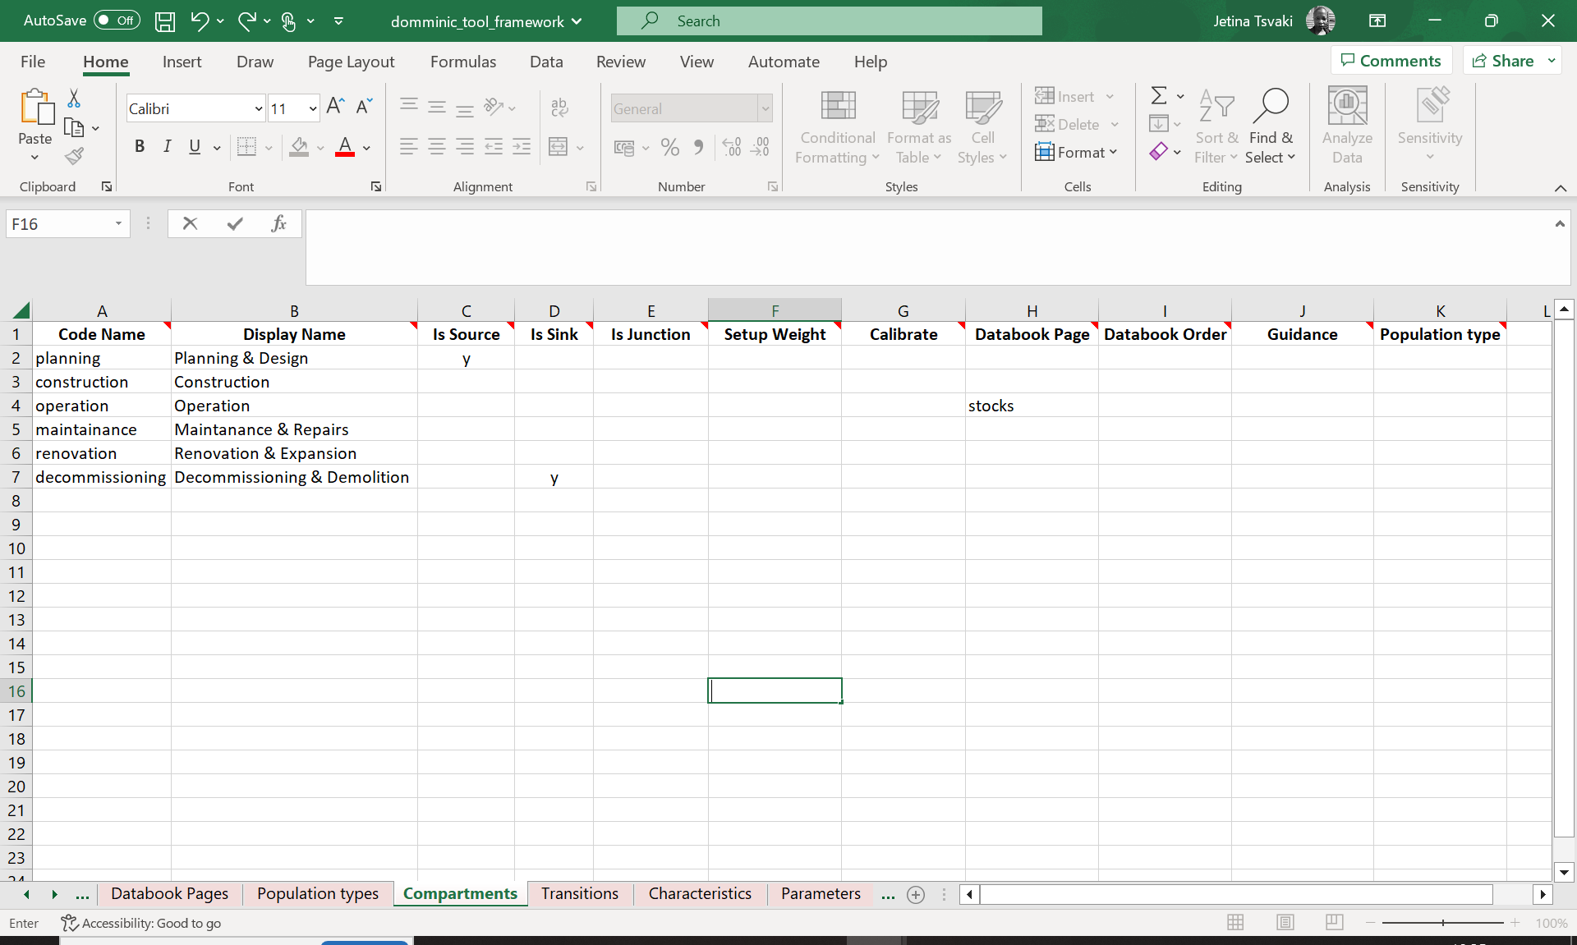

Slide 8
Concerns & Questions
We may not have rate or numbers associated with emissions in each compartment. This may require us to use another approach, such as time series, to estimate carbon emissions, which we can optimize
T1 : You can have as many or few pages as required in the databook? Uncertainty not automatically calculated in atomica rather manually,
T2: It is recommended that all parameter intended for explicit data calibration be placed on a single calibration sheet. Are not all parameters part of calibration ?, etc

